Slide 1
Sending Data into a Function
ELEC1006: ENGINEERING COMPUTING

Slide 2

Sending Data into a Function
Values can be passed into a function at time of call:
c = pow(a, b);
(Note: This function needs #include <cmath> to work)
Values passed into a function are arguments.
Variables in a function that hold the values passed as arguments are parameters.
PAGE 2

Slide 3
A Function with a Parameter Variable
void displayValue(int num)
{
cout << "The value is " << num << endl;
}
The integer variable num is a parameter. It accepts any integer value passed to the function.
PAGE 3

Slide 4
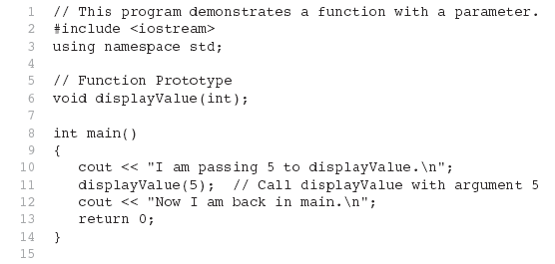
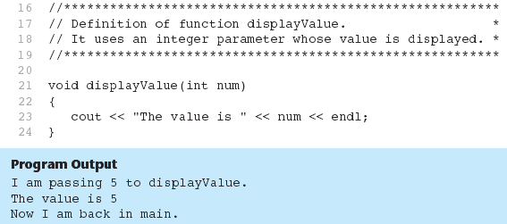
Only data type
Full declaration
PAGE 4

Slide 5
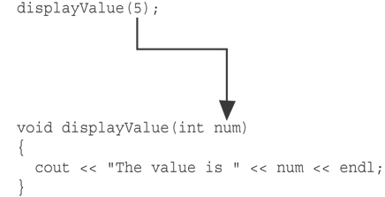
argument
The function call in line 11 passes the value 5
as an argument to the function.
PAGE 5

Slide 6
Passing Multiple Arguments
When calling a function and passing multiple arguments:
the number of arguments in the call must match the prototype and definition
the first argument will be used to initialize the first parameter, the second argument to initialize the second parameter, etc.
PAGE 6

Slide 7
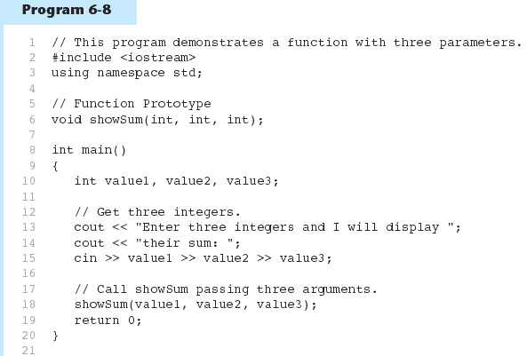
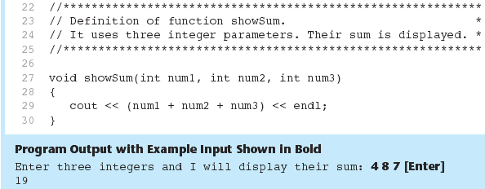
Only data type
Full declaration
PAGE 7

Slide 8
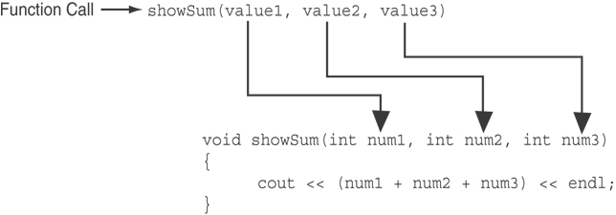
The function call in line 18 passes value1,
value2, and value3 as a arguments to the
function.
PAGE 8

Slide 9
Passing Data by Value
Pass by value: when an argument is passed to a function, its value is copied into the parameter.
Changes to the parameter in the function do not affect the value of the argument.
Example: int val=5;
evenOrOdd(val);
evenOrOdd can change variable num, but it will have no effect on variable val.
val
num
5
5
argument in
calling function
parameter in
evenOrOdd function
PAGE 9

Slide 10
More info
[1] cplusplus.com: Functions
https://cplusplus.com/doc/tutorial/functions/
[2] learncpp.com: 2.3 – Introduction to function parameters and arguments
https://www.learncpp.com/cpp-tutorial/introduction-to- function-parameters-and-arguments/
PAGE 10

